Slide 1

What is virtualization?

Slide 2
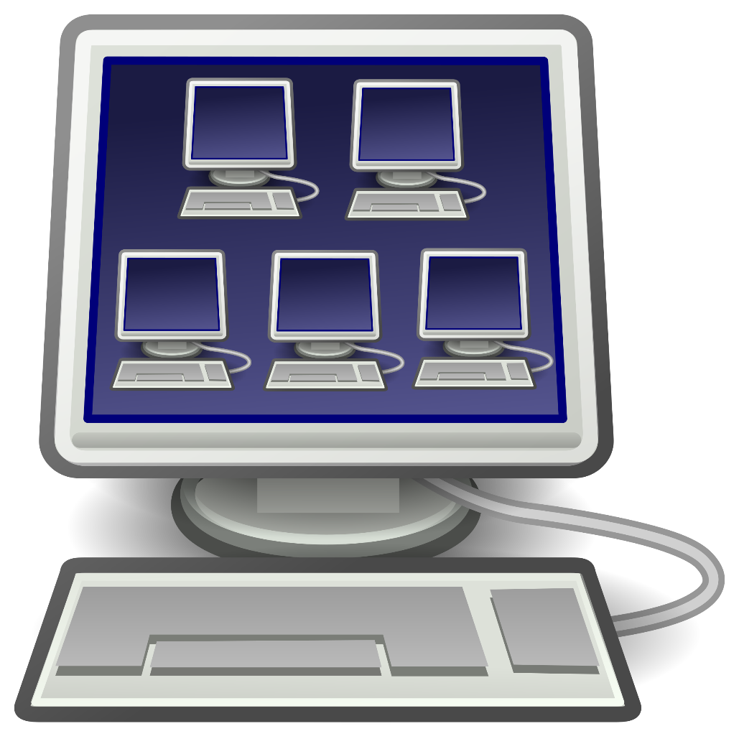
One host (Computer) running multiple or different operating systems.

Slide 3
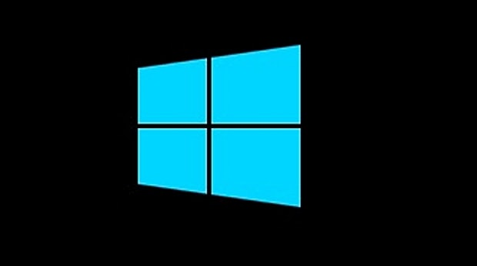


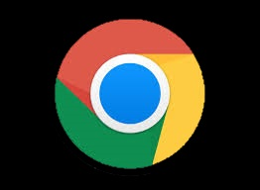

Slide 4
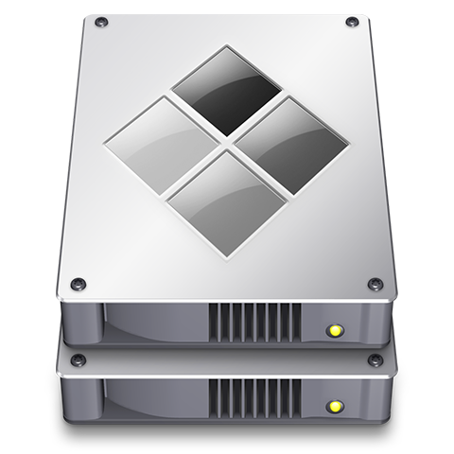
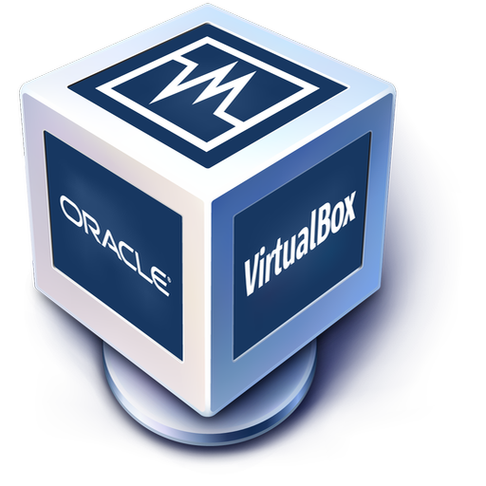

OSX Bootcamp
VirtualBox
VMWare

Slide 5

Existing: Memory, CPU and Hard drive space

Slide 6




